Slide 1
IPR The Agile Team
Christina Gu
Jason Lee
Stephen Smith

Slide 2
Outline
-Project Overview
-Milestone Status
-Continuing Research Effort
-Work to be Done
-Issue Detail
-Earn Value Analysis

Slide 3
Project Overview
PROBLEM STATEMENT RECAP:
Are there benefits from using Agile Software
Development methodologies versus Waterfall and
Spiral in the Context of Systems Engineering Products
Compare Agile with traditional Systems Engineering in terms of: Cost, Schedule, and Quality

Slide 4
MILESTONE STATUS
Table Name | Planned Finish | Actual | STATUS
THE AGILE TEAM | Fri 5/10/13 | Fri 5/10/13
Problem Definition | Mon 2/4/13 | Mon 2/4/13
Project Proposal | Mon 2/18/13 | Mon 2/18/13
Written Proposal | Mon 2/25/13 | Mon 2/25/13
Finalize Scope | Mon 3/4/13 | Mon 3/25/13
Meet with Sponsor | Thu 3/7/13 | Thu 3/7/13
Negotiate Scope | Thu 3/14/13 | Thu 3/21/13
Get Stakeholder Buy-in on Scope Definition | Mon 3/4/13 | Mon 3/25/13
Website | Mon 3/11/13 | Mon 3/11/13
IPR | Mon 3/18/13 | Mon 3/18/13
Metrics Development | Mon 3/25/13 | Thu 3/28/13
Team Meeting with Professor | Mon 4/1/13 | Mon 4/1/13
Meeting: Status w/ Professor | Mon 4/1/13 | Mon 4/1/13
Data Analysis | Mon 4/15/13 | Mon 4/15/13
Final Report | Fri 4/26/13 | Fri 4/26/13
Present Report to Sponsor | Fri 4/26/13 | Fri 4/26/13
Final Presentation | Fri 5/10/13 | Fri 5/10/13
Legend:
 | Completed on time
 | Delayed
 | on Schedule

Slide 5
What was Done
Research and Information Gathering
Data suitable for analysis
Development of Evaluation Metrics
Involve Sponsor to support Metrics
Analysis of Data
What the data really says
Presentation of Results
Clear, Robust, Concise, Persuasive
Getting a clear understanding of the sponsor’s needs and scoping down the problem to satisfy all of the Stakeholders involved.

Slide 6
What was Done-cont.
Met with sponsor for clear direction on their needs for the project
The results were that the sponsor wanted more research into how documentation is affected by Scrum Agile development
The sponsor wanted the effort to be more general, not Boeing-specific
Redirected research efforts to align with new sponsor direction

Slide 7
Research Efforts
Narrowing MIL-STD-498 to most applicable systems engineer documents:
Requirements: SSS, SRS, IRS
Design: SSDD, SDD, IDD
Qualification/Test: STP, STD
Operational Manuals: SUM
Software Manuals: SVD
The research is now focused on Agile methods of developing these specific documents.
The research includes methodologies for including documentation as part of the Agile development cycle.

Slide 8
What Needs to be Done
More input is needed from various stakeholders
Research on individual documentation generation using Agile
Generating a characterization of each documentation
How is it generated
When is it generated
What it’s used for
Is it different from a traditionally developed document?
Does the documentation ownership change?

Slide 9
What Still Needs to be Done
A cost analysis on documents generated using Agile based on research found on schedule differences.
Will be done with hypothetical cost data numbers due to sponsor data limitation.
The cost/schedule analysis is secondary and may be scoped out with further discussion with sponsor.

Slide 10
Issue Detail
Issue 1: Scope
Issue 2: Restricted Schedule
Description: tied directly to our primary risk: Scope
Impact: Continued deliberation with stakeholders delays project schedule
Team Action: Assigned team Issue 1 owner
Key resources: Team 6, Boeing, GMU Faculty
Resolution Deadline: 3/25/13
Description: Scope changes have pushed schedule back
Impact: More work to be done by the team, in less time
Team Action: Increase burn rate to make up schedule loss
Key resource: Team 6 time investment
Resolution Deadline: 4/19/13

Slide 11
Earned Value Analysis

Slide 12
Questions?

Slide 13
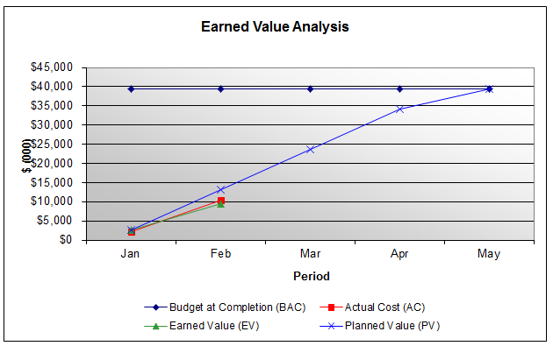
Backup: EV Trend Analysis

Slide 14
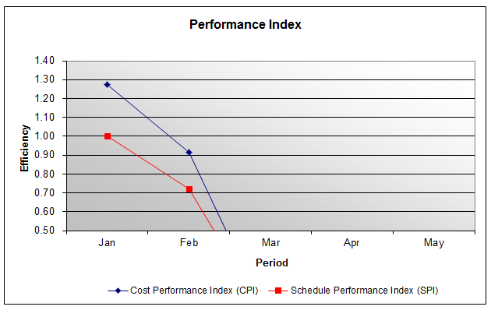
Backup: EV Trend Analysis

